Slide 1
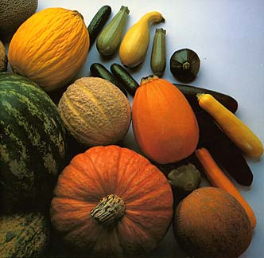
How to Hand-Pollinate Cucurbits
Pumpkins, squash, melons, and cucumbers
A presentation by the New Jersey Agricultural Society’s Learning Through Gardening Program

Slide 2
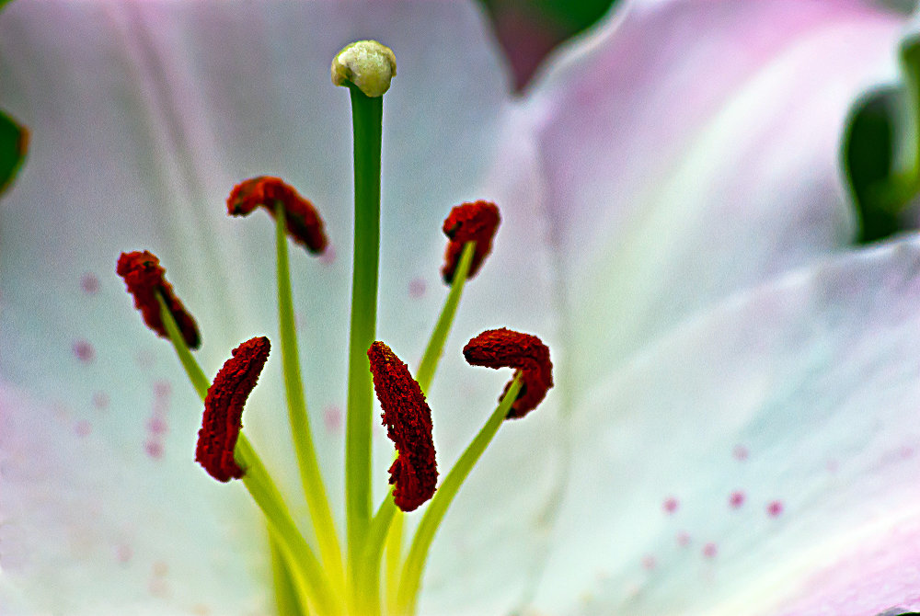
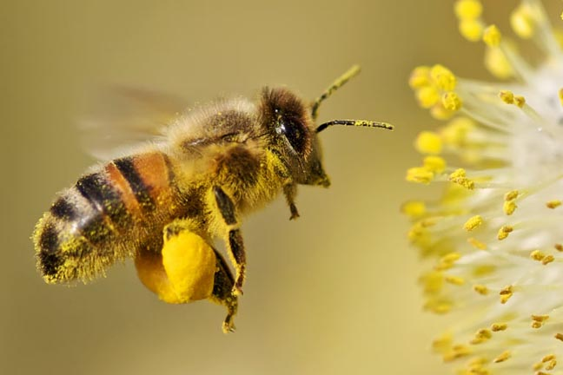
Perfect Flowers
Most flowers have both male and female parts. These are called perfect flowers. The female part, the pistil, is in the middle. The male parts, the stamens, surround the pistil. Pollination happens when a pollinator moves pollen from the stamens to the top of the pistil.

Slide 3
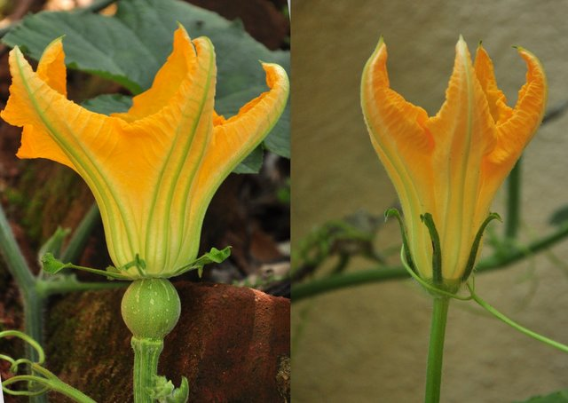
Imperfect Flowers
Some flowers have only male parts or only female parts. These are called imperfect flowers. A group of vegetables that have imperfect flowers are the cucurbits, which include cucumbers, squash, and melons.
You can tell the female and male flowers of cucurbits apart easily because the female flower has a small, immature fruit beneath it. The male flower does not.

Slide 4
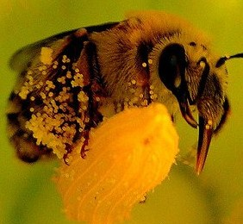
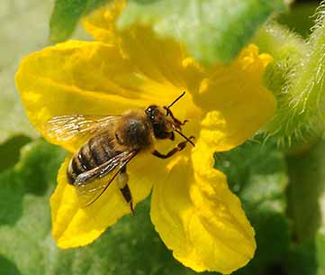
Imperfect Pollination is Tricky
For pollination to occur in a plant with imperfect flowers, a pollinator must first stop on the male flower and attract the pollen, and then stop on a female flower and release the pollen. That’s why you will more often see flowers on your cucumbers and pumpkins that never turn into fruit.

Slide 5
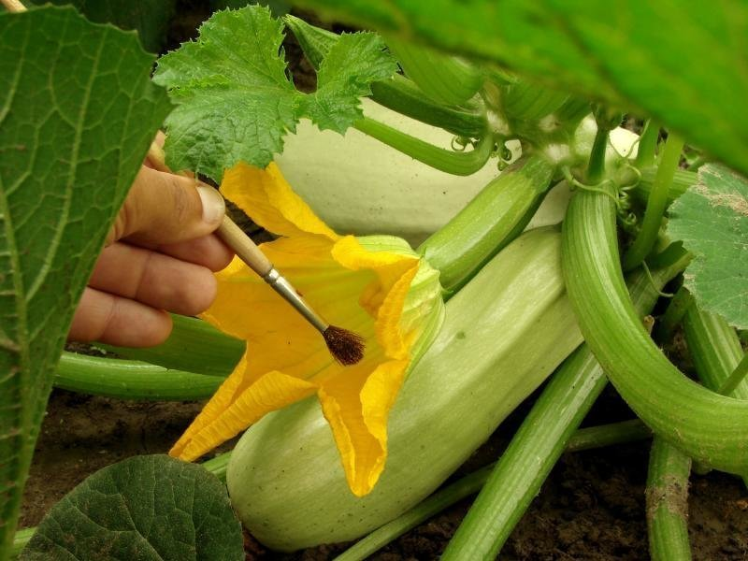
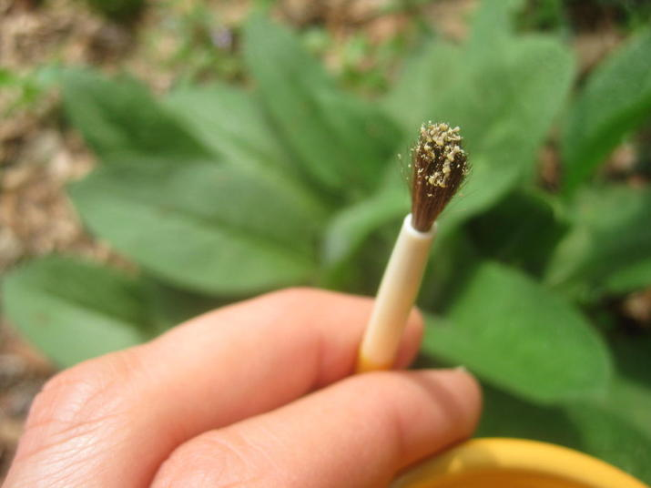
Hand-Pollination
You can help the pollination process in your cucurbits along by hand-pollinating them.
First, take a small paint brush or Q-tip and brush it against the top of the stamens on the male flower to gather the pollen.

Slide 6
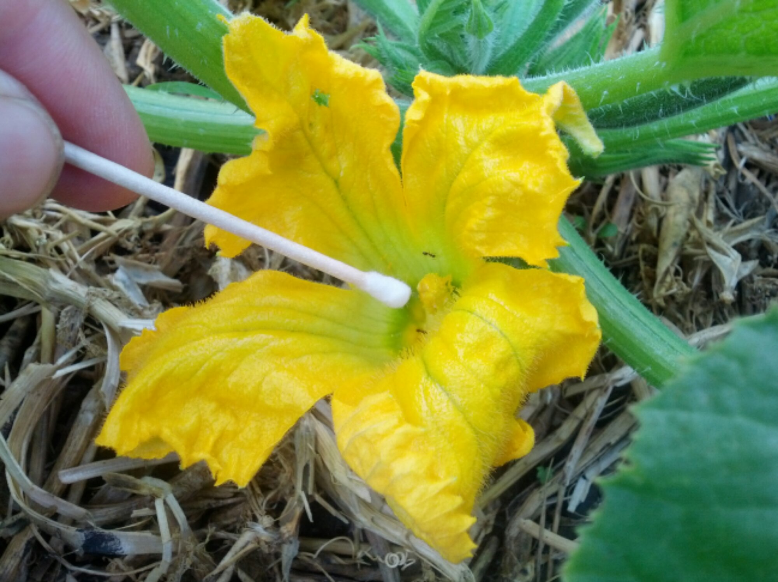
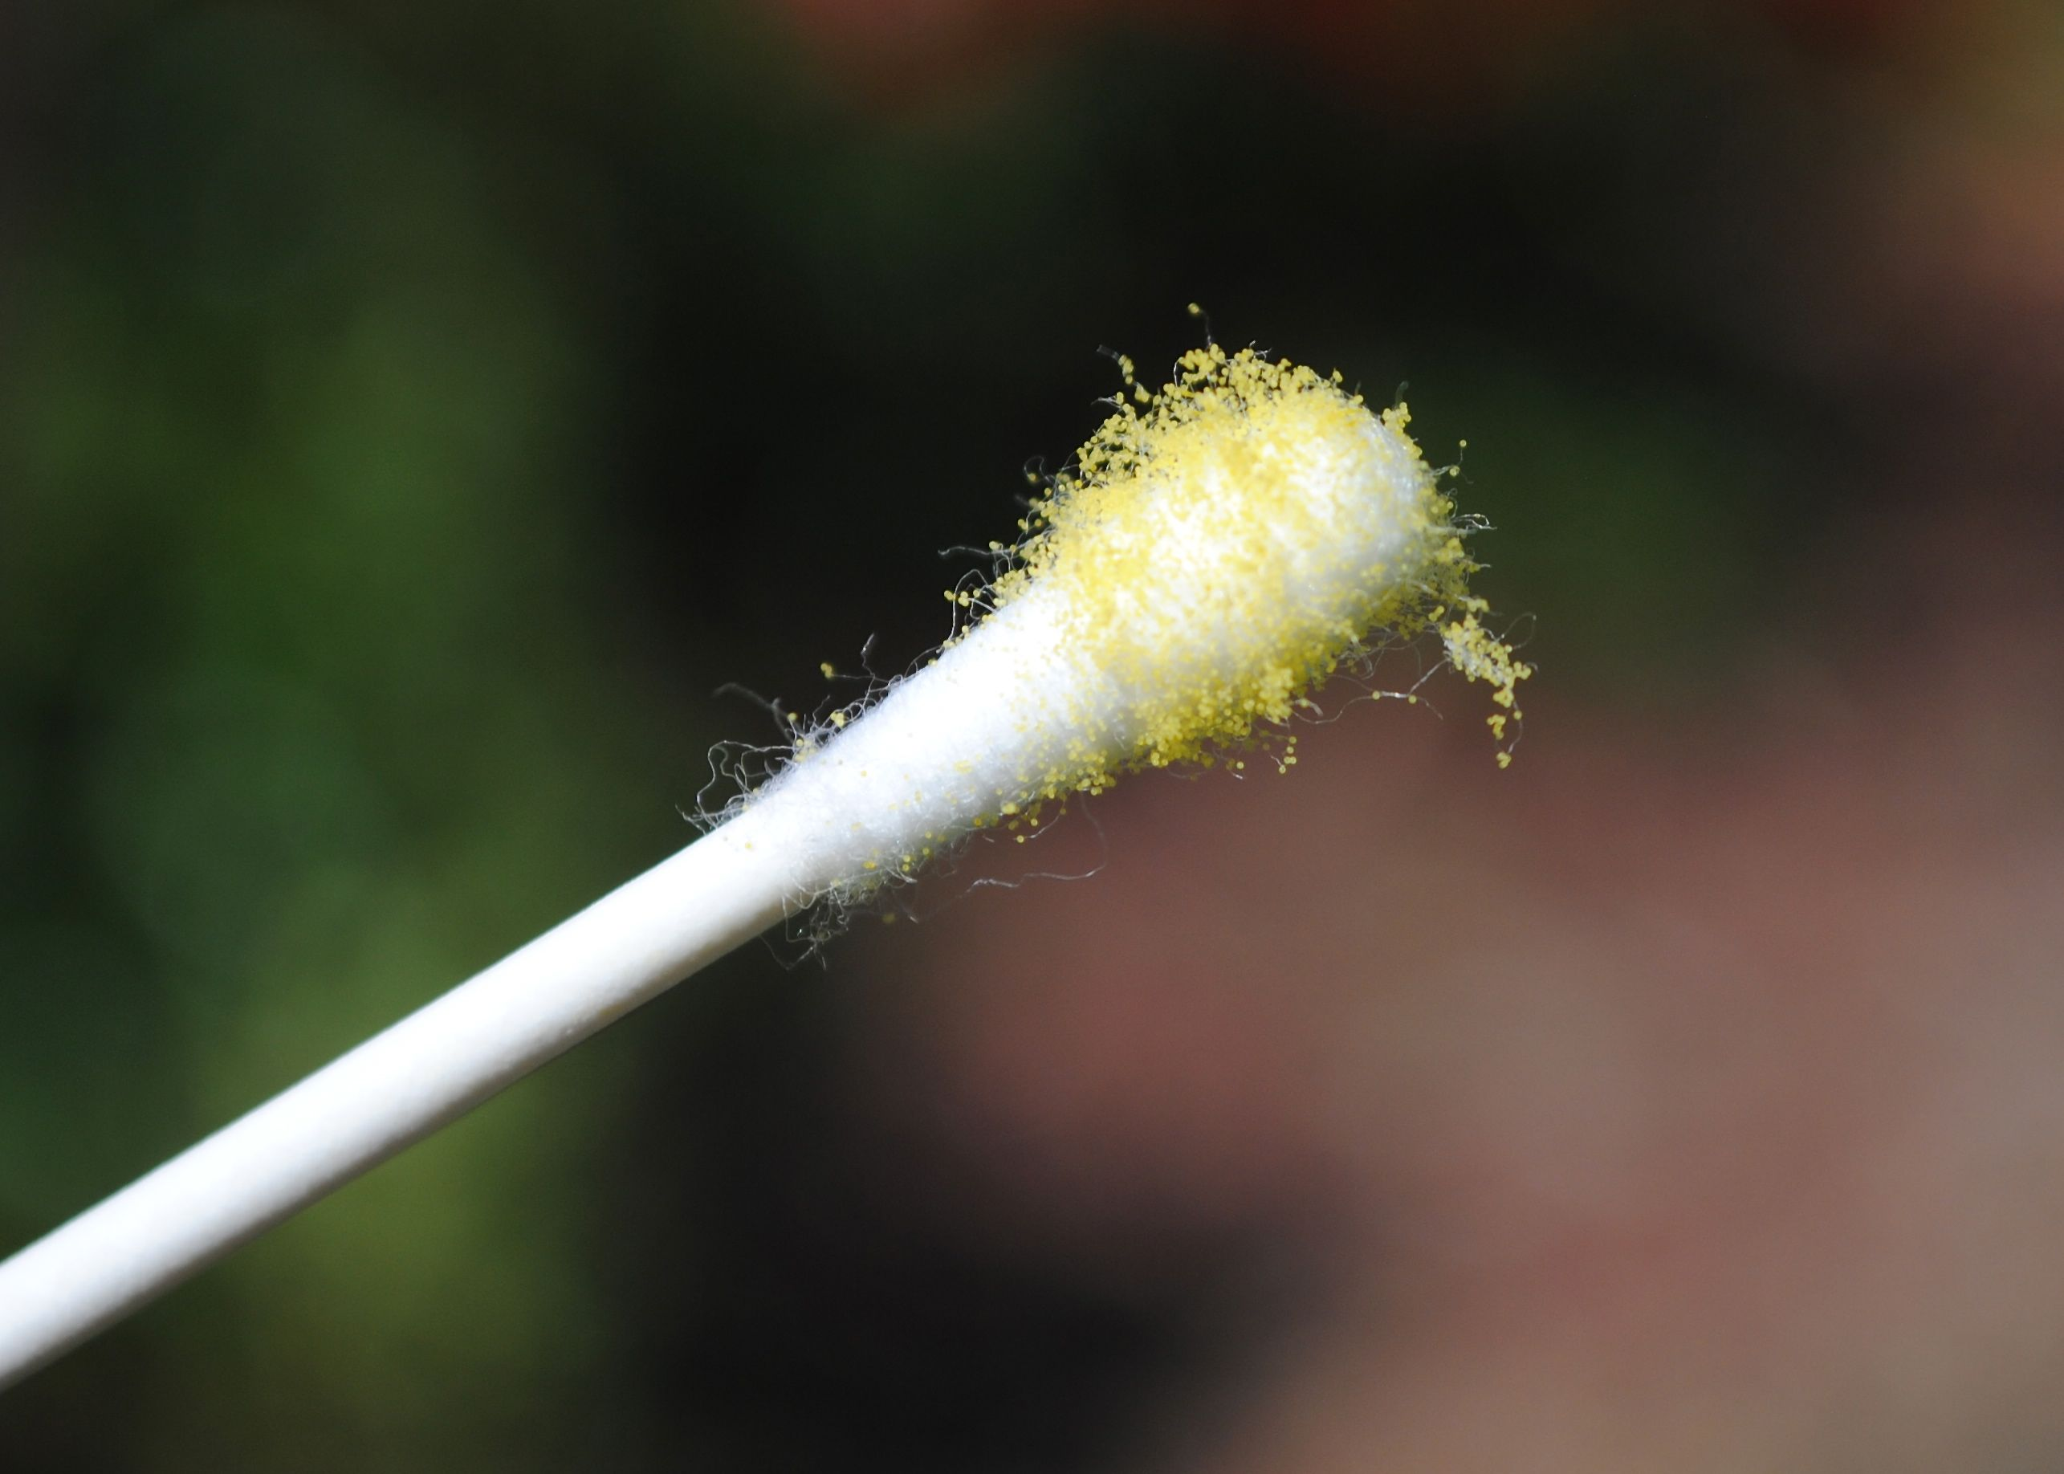
Hand-pollination
Then brush the paint brush or Q-tip against the top of the pistil on the female flower to release the pollen.

Slide 7
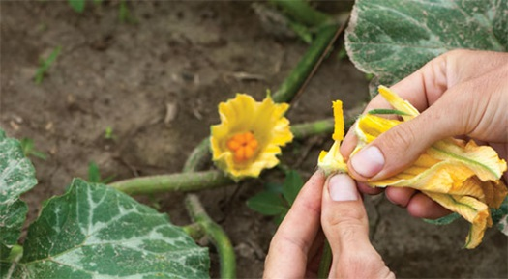
Another Strategy
Another way to hand-pollinate is to pick a male flower and remove all the petals.

Slide 8
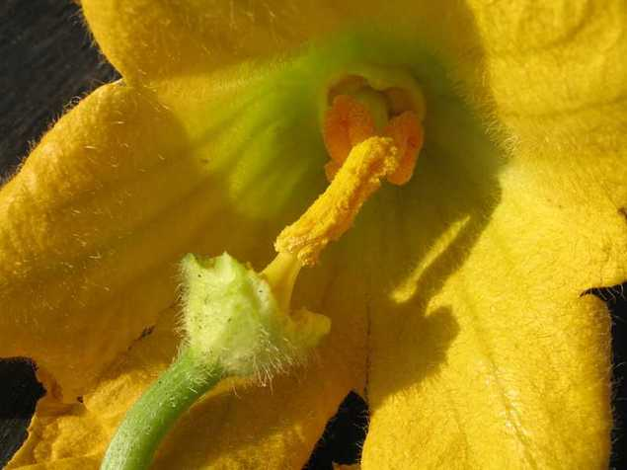
Then gently brush the stamen against the pistil of a female flower.

Slide 9
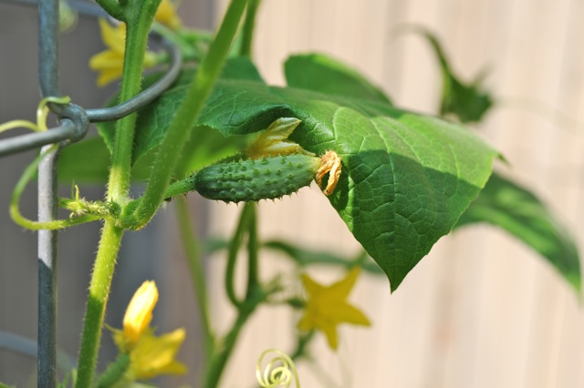
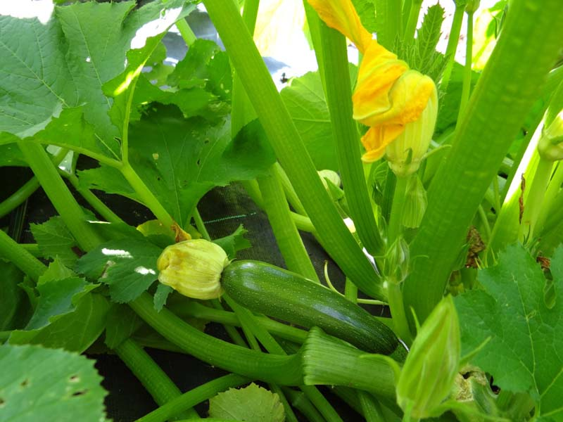
Hand pollinating your cucurbits can help them bear more fruits. Try it with your students!

